Slide 1


DEEPFAKE DETECTION SYSTEM
By Group 7,
Sreejith Mohan
Vishnudas T
Jisto Kuriakose
Mithun Raju

Slide 2
Contents
INTRODUCTION
WHY DEEPFAKE DETECTION?
HOW DEEPFAKE ARE CREATED?
SYSTEM ARCHITECTURE
DATASET EXPLORATION
PRE-PROCESSING
DATASET SPLIT
MODEL ARCHITECTURE
TRAINING WORKFLOW
PREDICTION WORKFLOW
TOOLS AND TECHNOLOGIES
RESULTS
CONCLUSION
FUTURE SCOPE

Slide 3

Problem Statement
To Design and Develop a Deepfake detection system to classify the video as deepfake or pristine.

Slide 4
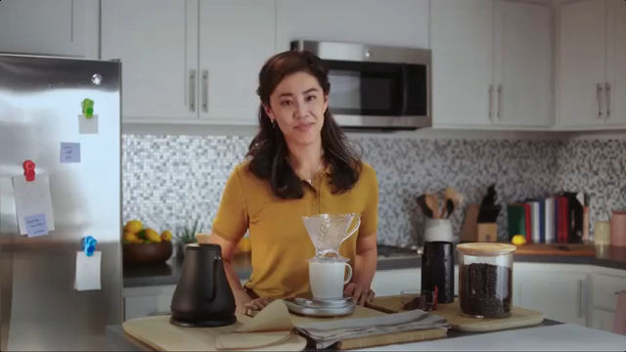
Introduction
Deep fake is a technique for human image synthesis based on artificial intelligence.
Deep fakes are created by combing and superimposing existing images and videos onto source images or videos using a deep learning technique known as generative adversarial network.

Slide 5
Can we detect Deep fakes with naked eyes?

Slide 6
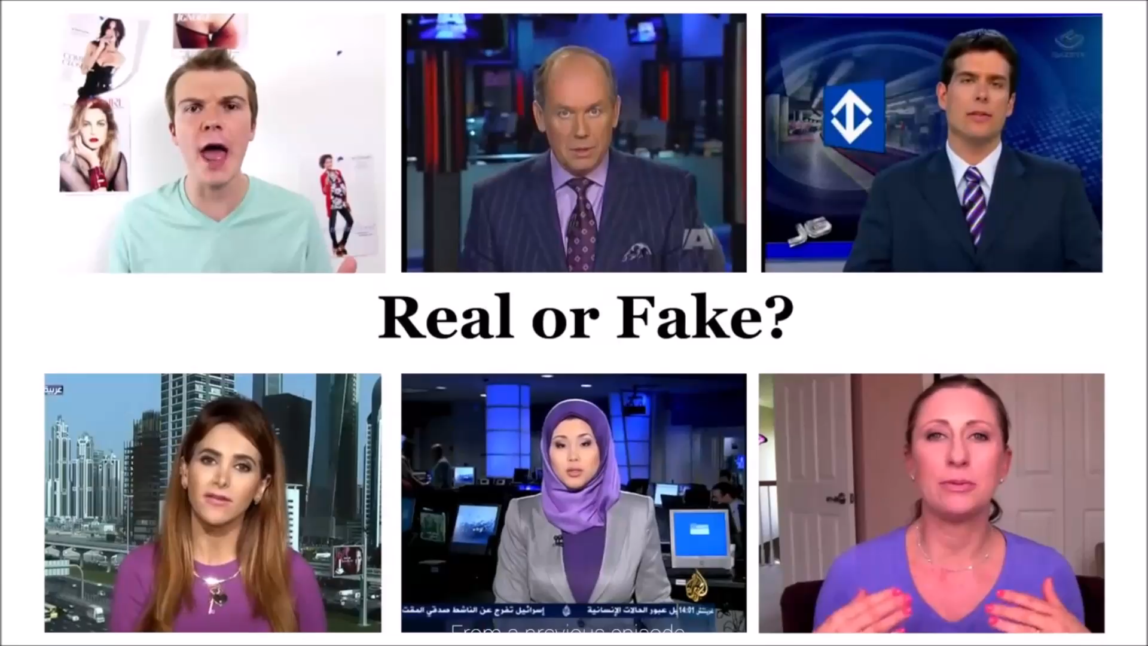
Fake or Real?

Slide 7
REAL
FAKE
FAKE
FAKE
FAKE
REAL

Slide 8


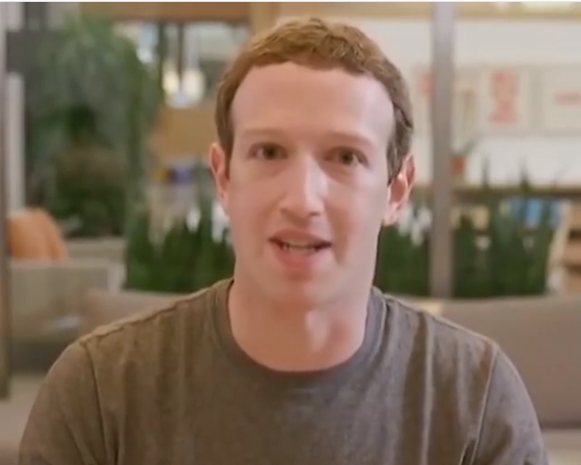
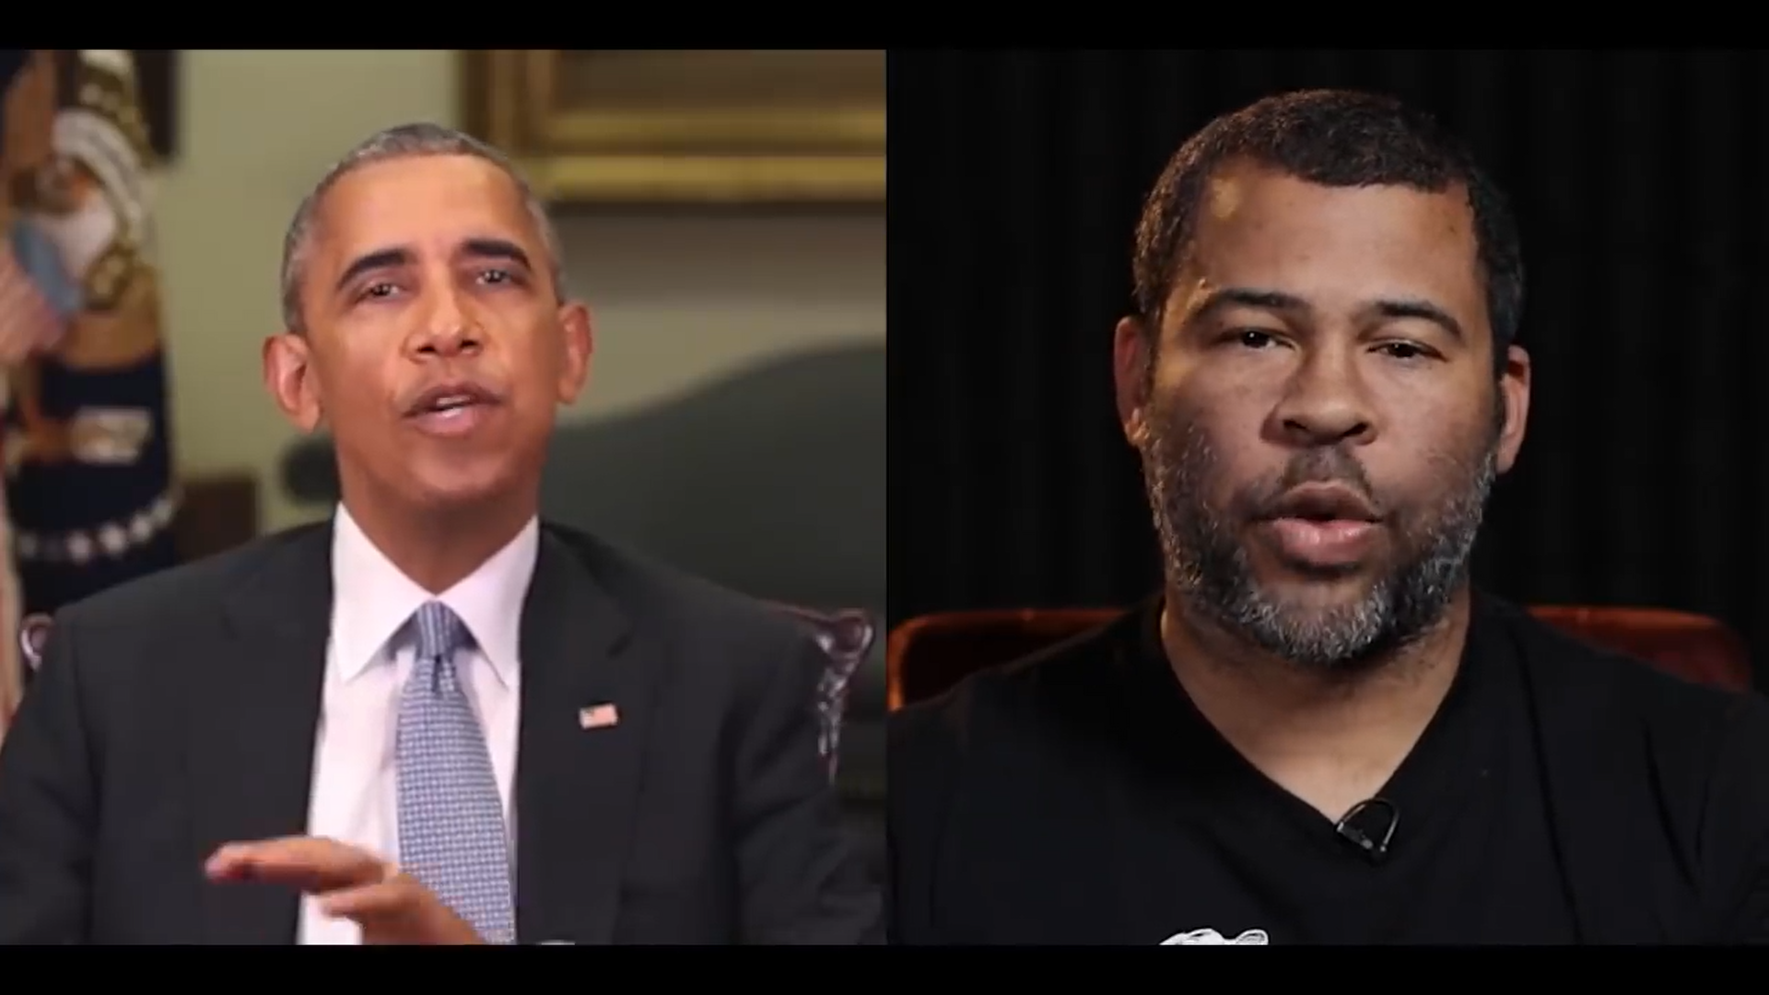
Why Deepfake Detection?
Fake News
Malicious hoaxes
Financial fraud
Celebrity unusual video
Revenge porn
Politician videos

Slide 9
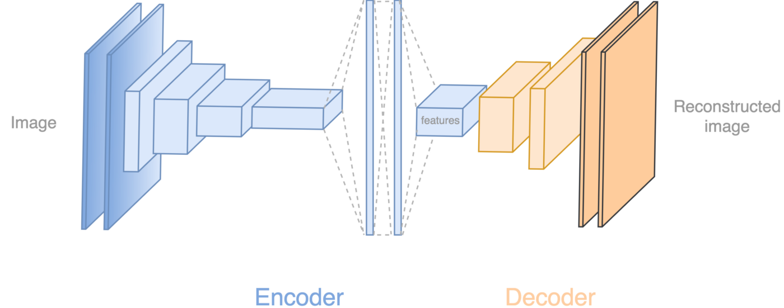
How Deepfakes are Created?
Tools for deep fake creation
Faceswap
Faceit
DeepFaceLab
DeepfakeCapsuleGAN
Large Resolution Facemasked

Slide 10
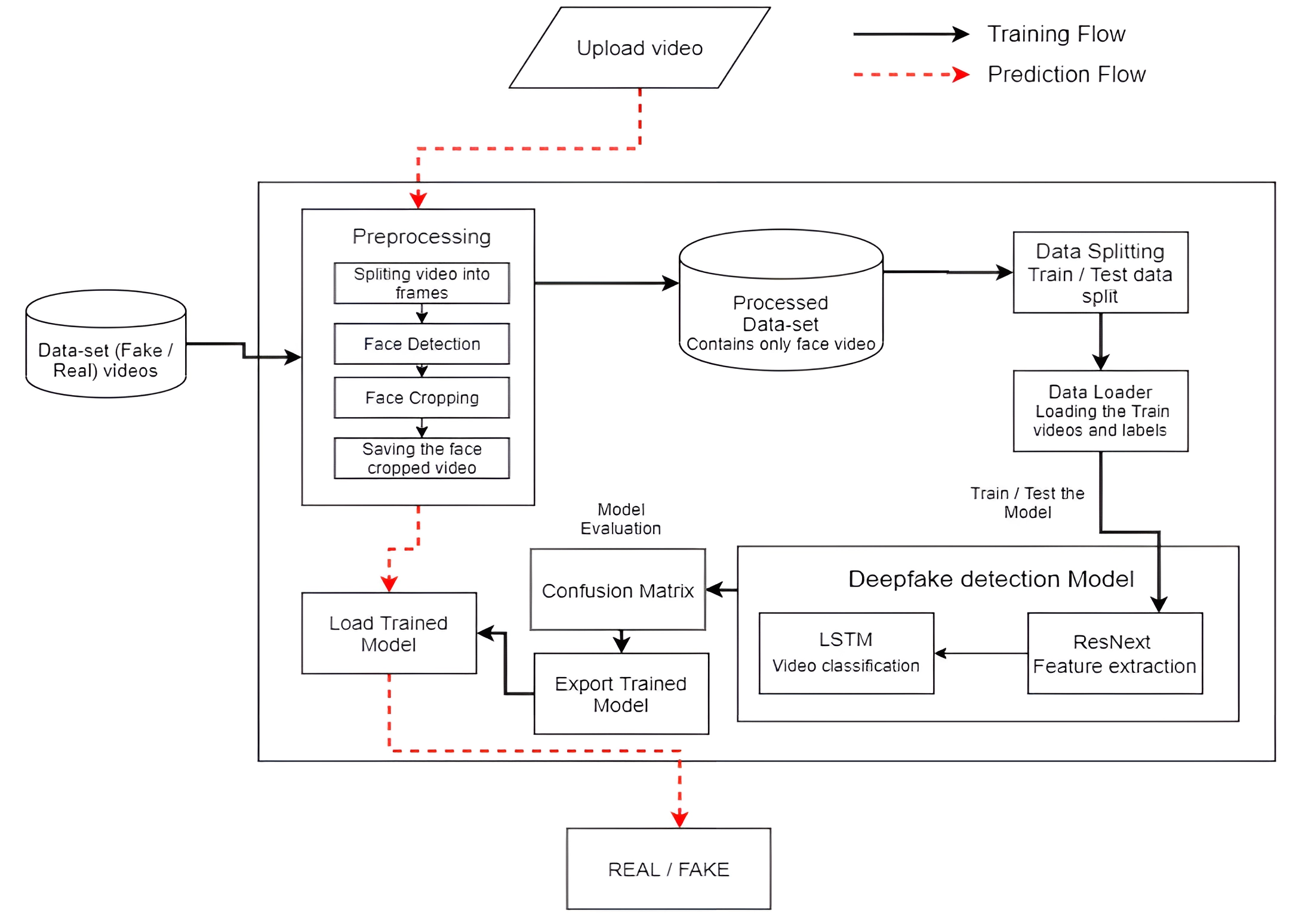
System Architecture

Slide 11
Architecture Design Stages
Dataset Gathering
01
02
Pre-processing
03
Dataset Split
Model Architecture
04
05
Training Workflow
06
Prediction Workflow

Slide 12
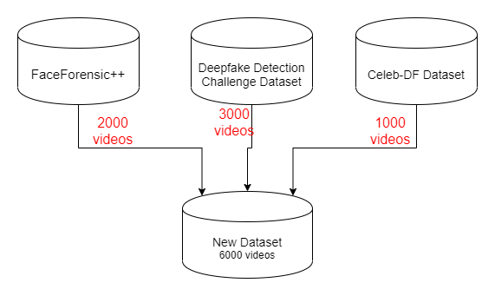
Dataset Gathering

Slide 13
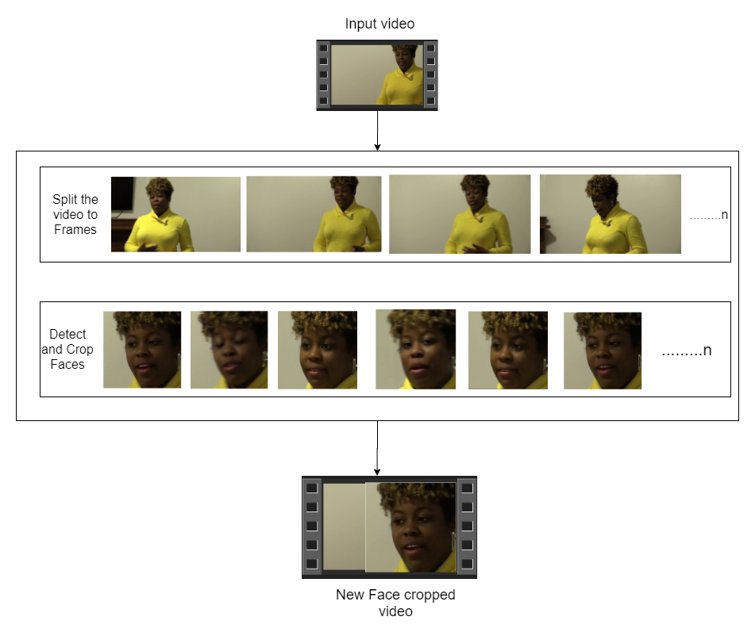
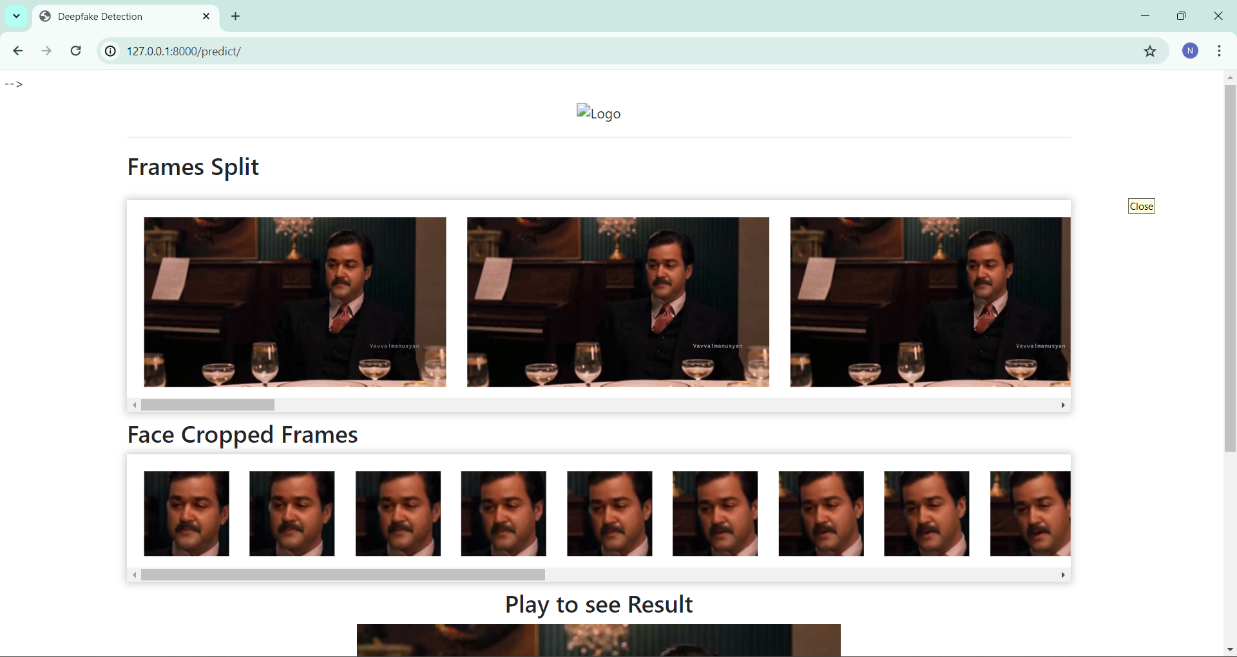
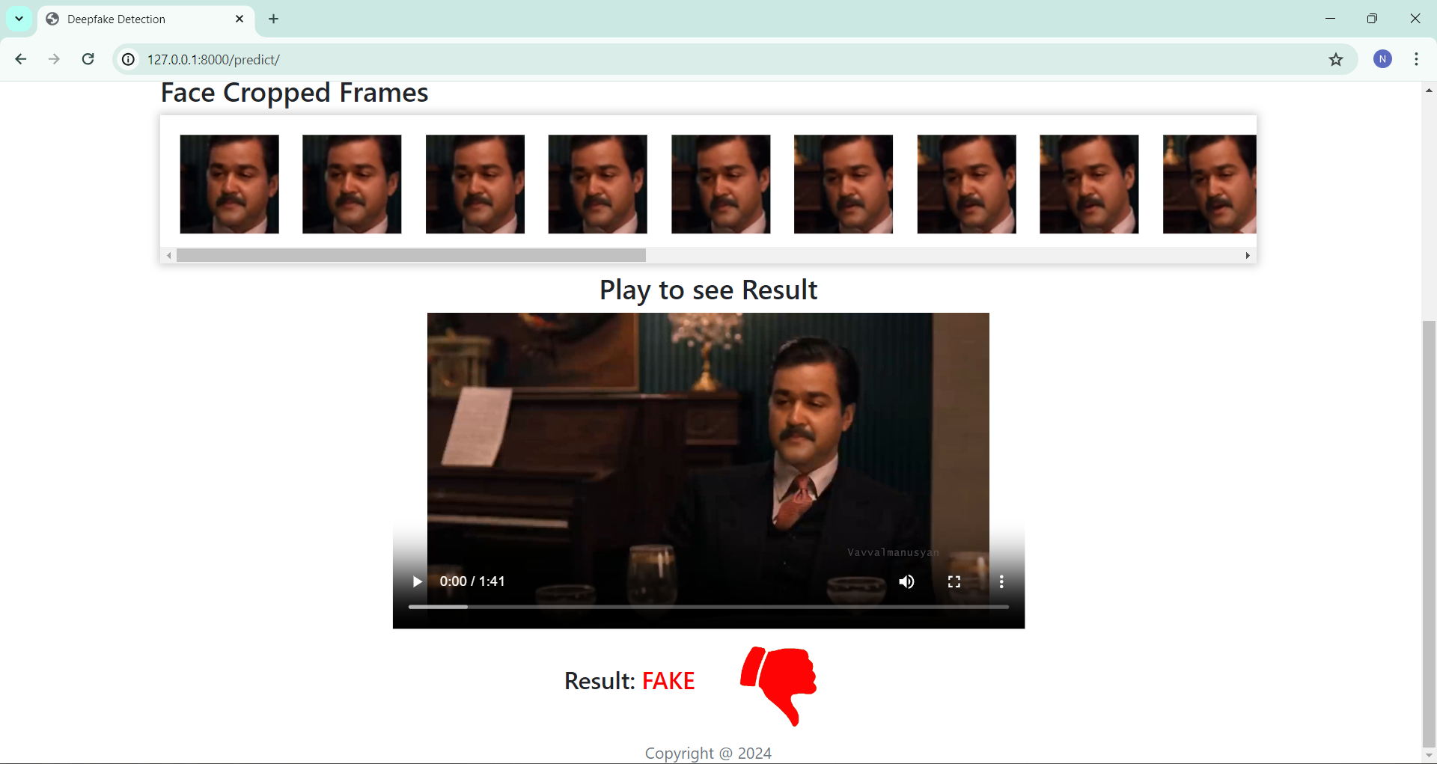
Pre-processing
Split video into frames
Face detection
Cropping face
Creating new face cropped video
Saving the face cropped video

Slide 14
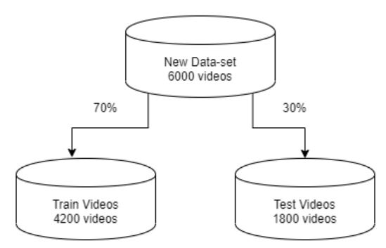
Dataset Split

Slide 15
Model Architecture
The model is a combination of CNN and RNN
The Pre- trained ResNext CNN model to extract the features at frame level and based on the extracted features a LSTM network is trained to classify the video as deepfake or Original

Slide 16
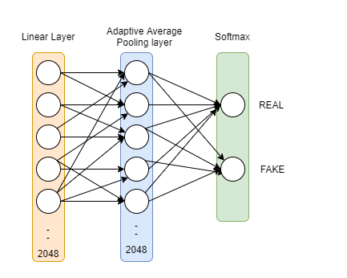
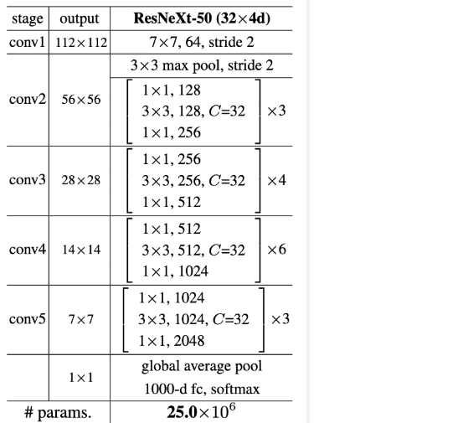
Model Architecture
ResNext-50
1 LSTM layer with 2048 shape input vector and 2048 latent features along with 0.4 chance of dropout
Sequential Layer

Slide 17
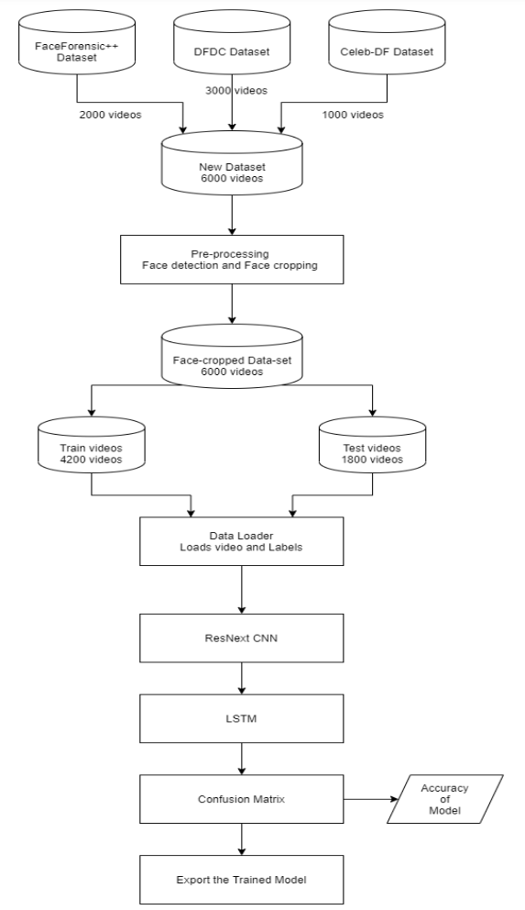
Training Workflow

Slide 18
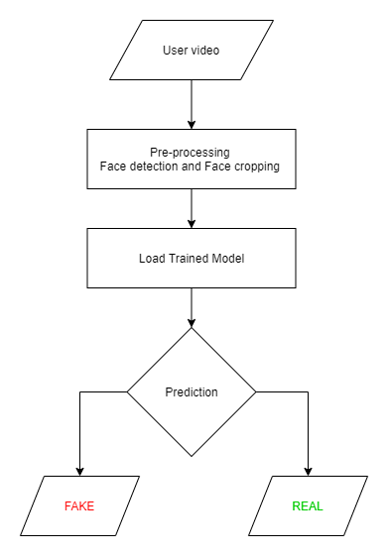
Prediction Workflow

Slide 19














Programming Languages
Python3
JavaScript
AAA
Programming Frameworks
PyTorch
Django
Tools and Technologies
IDE
Google
Jupyter Notebook
Visual Studio Code
Cloud Services
Google Cloud Platform
Version Control
Git

Slide 20
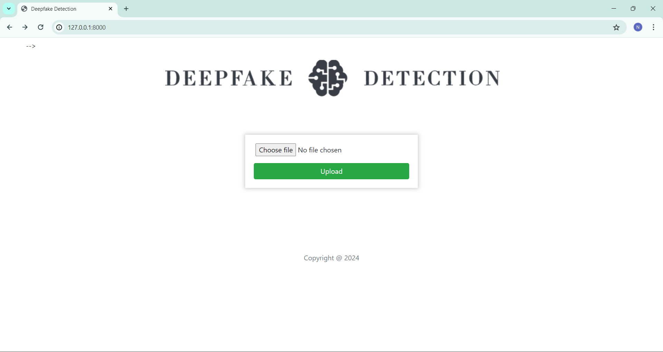
Home Page

Slide 21
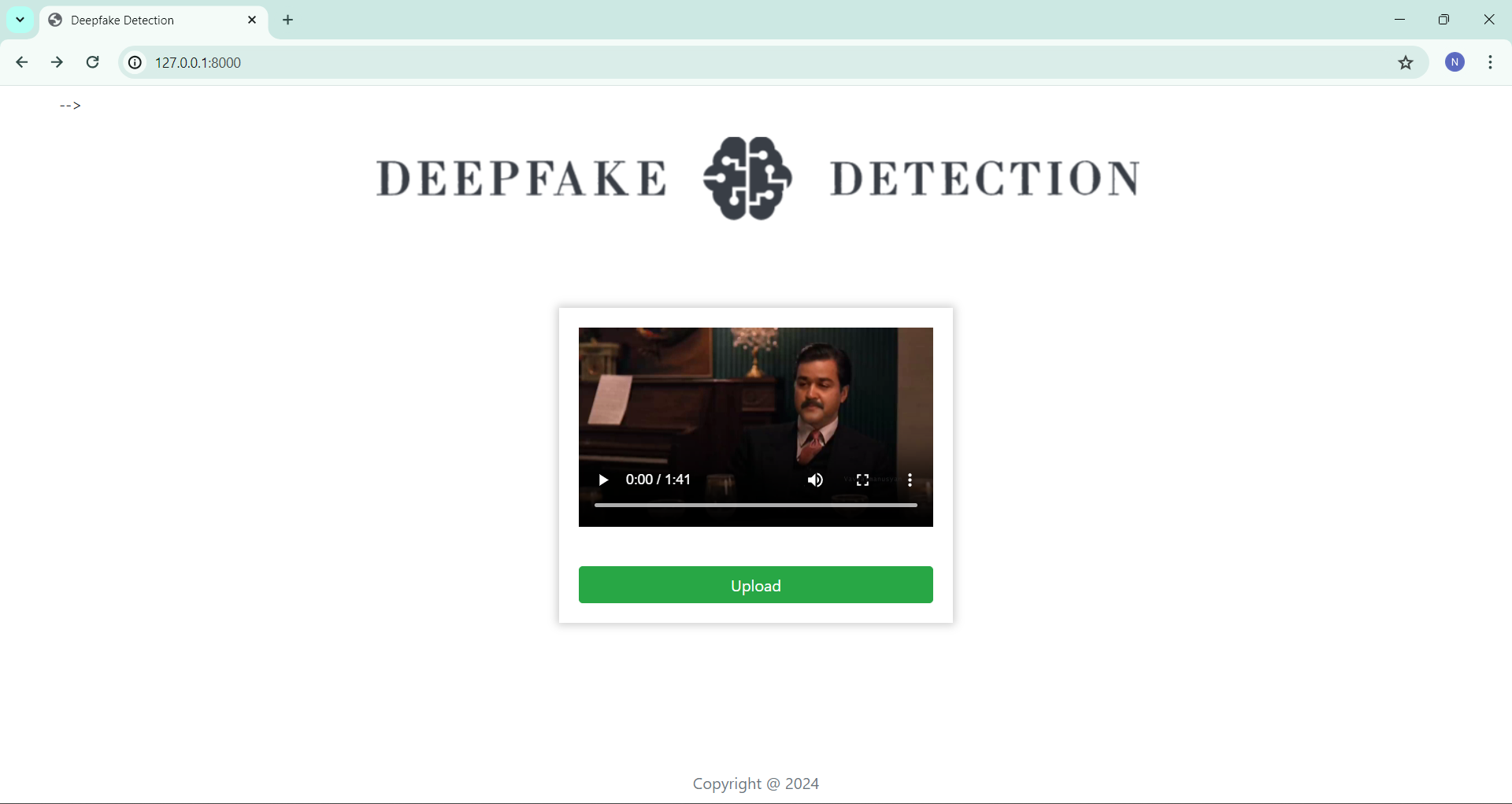
Upload Deepfake video

Slide 22
Output of deepfake video

Slide 23
Output

Slide 24
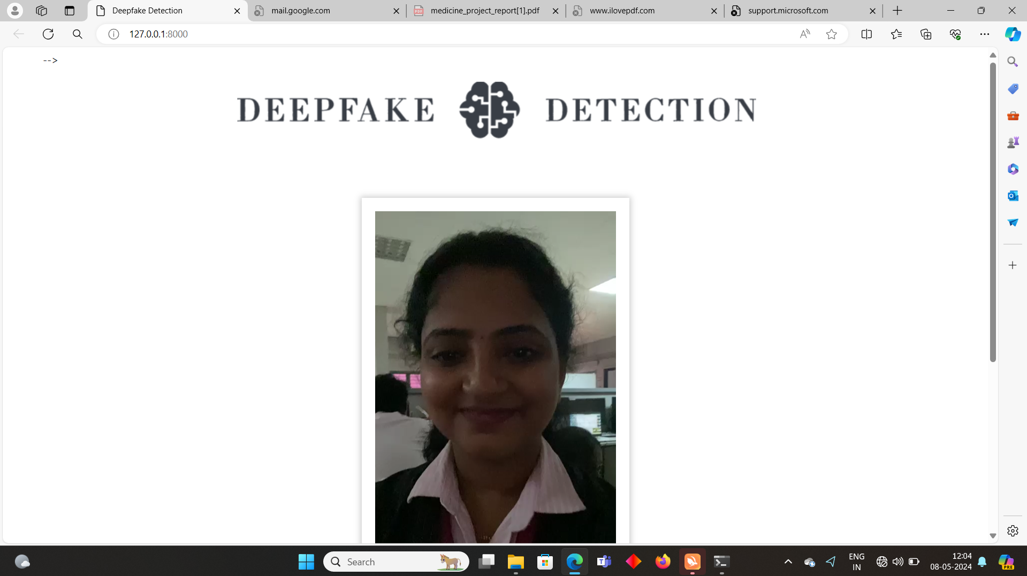
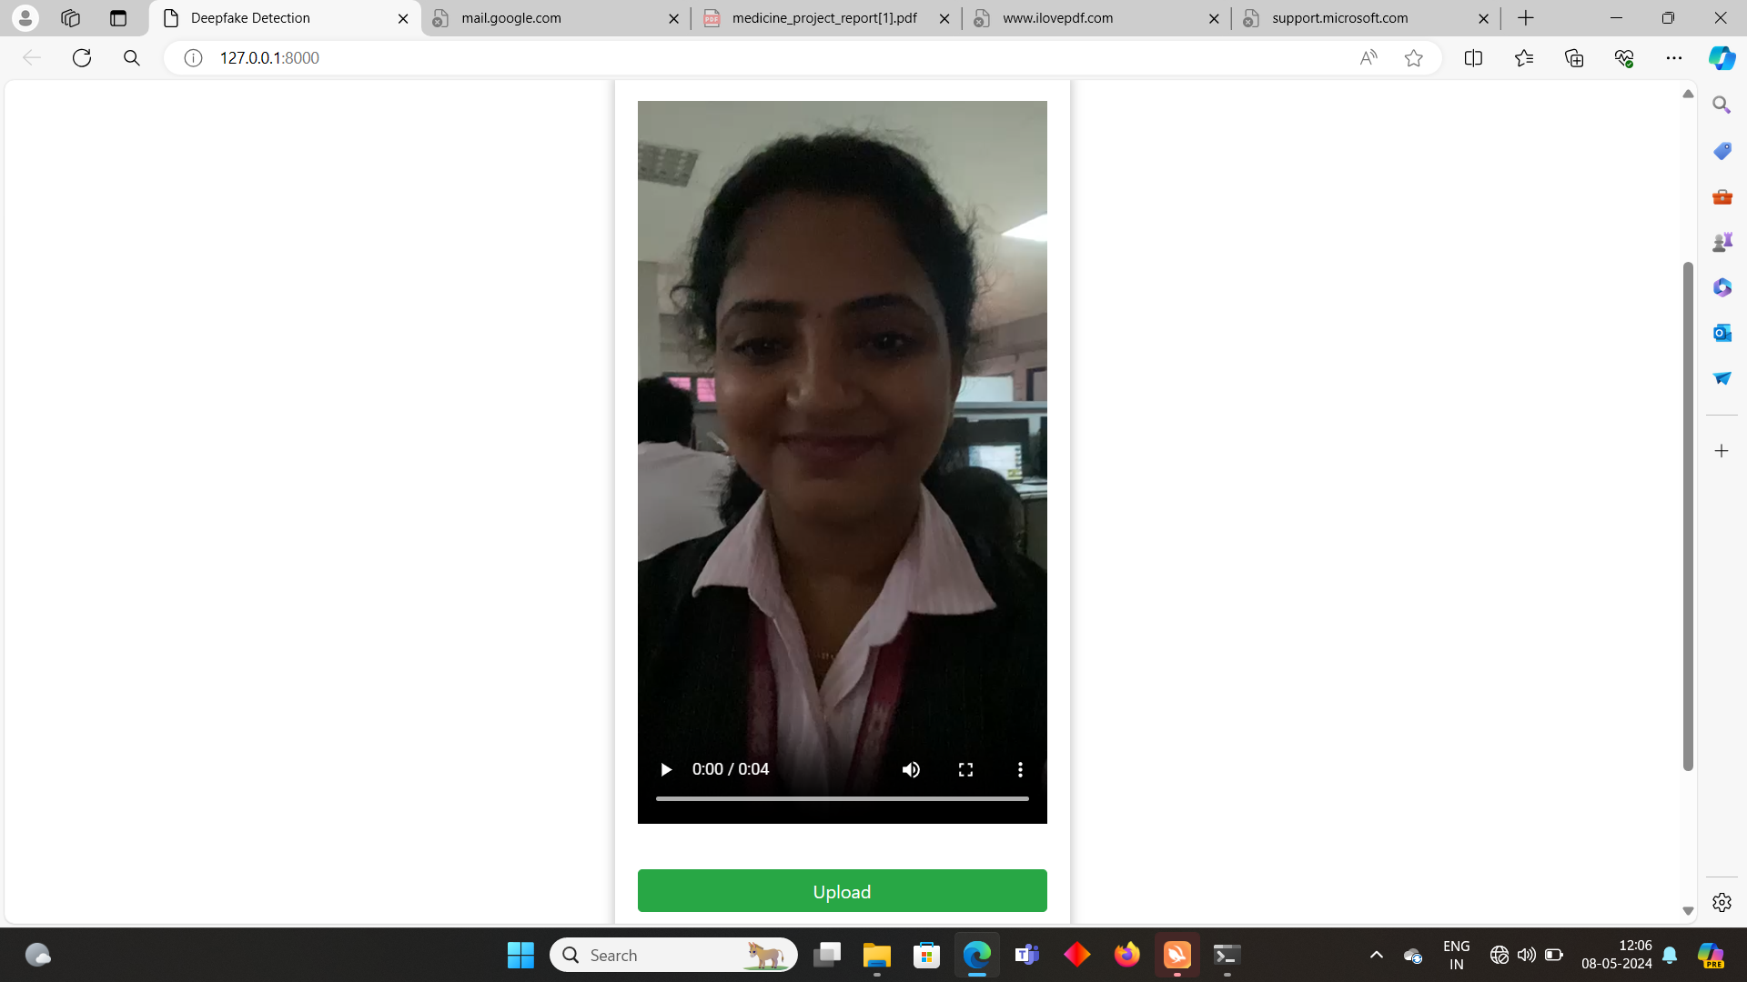
Upload a real video

Slide 25
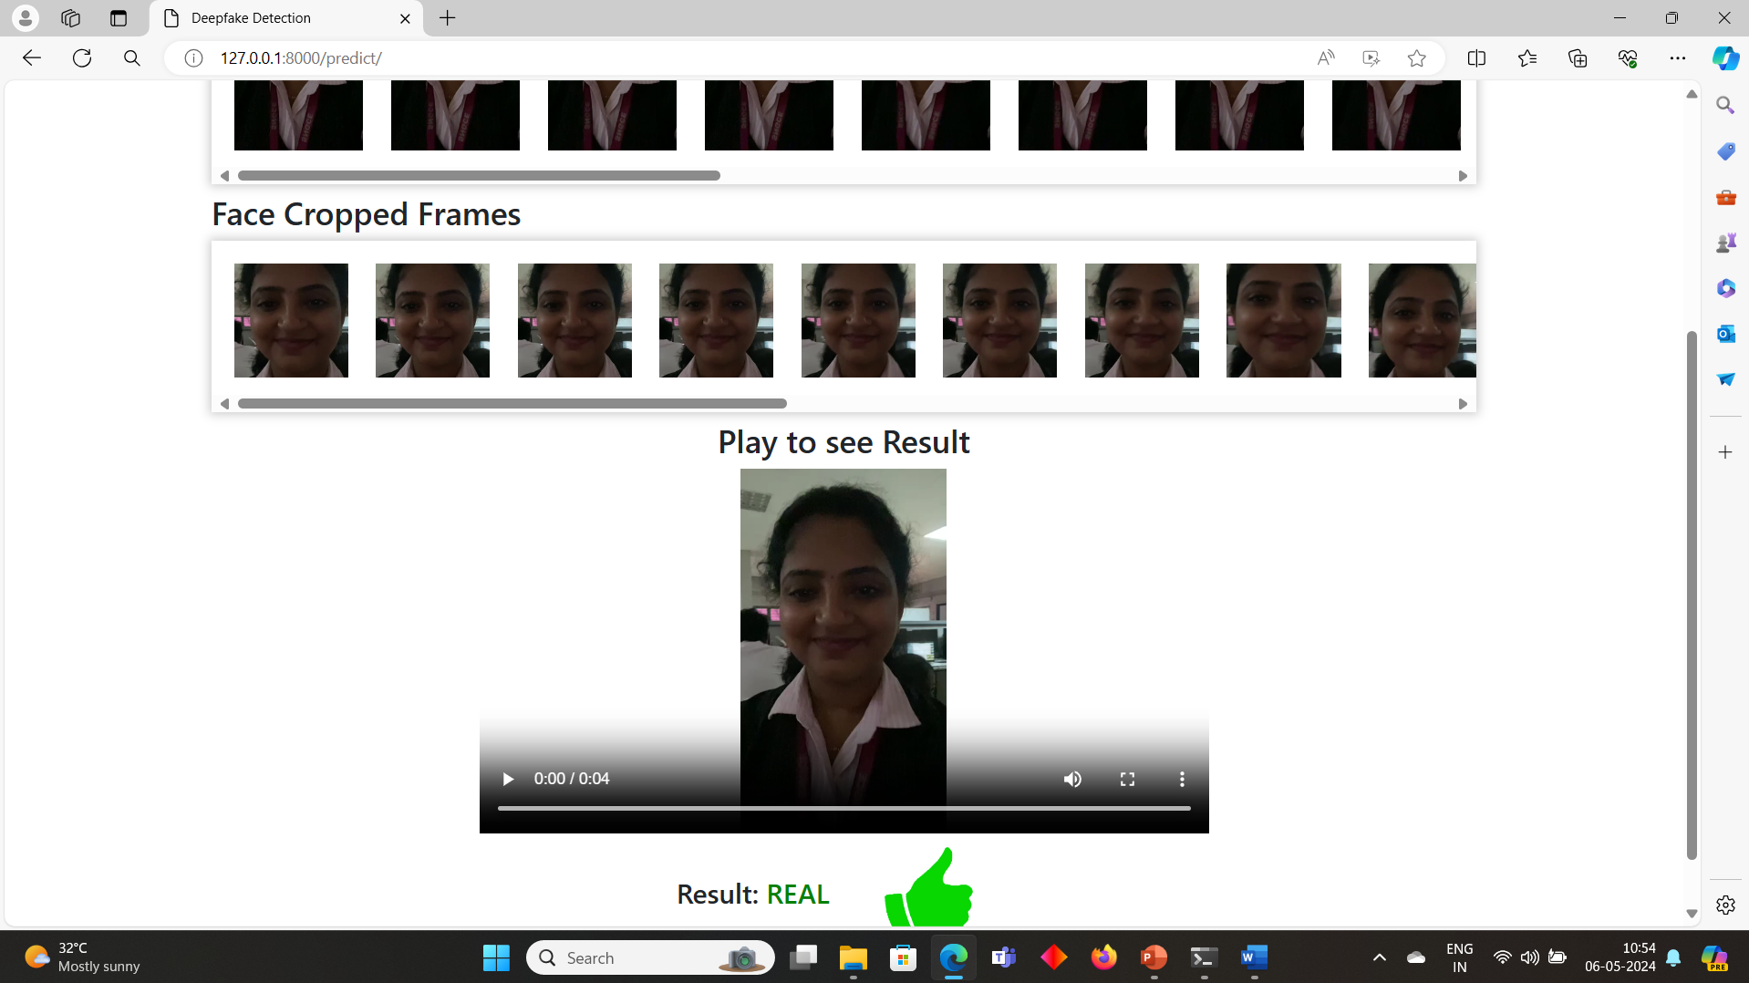
Output of real video

Slide 26
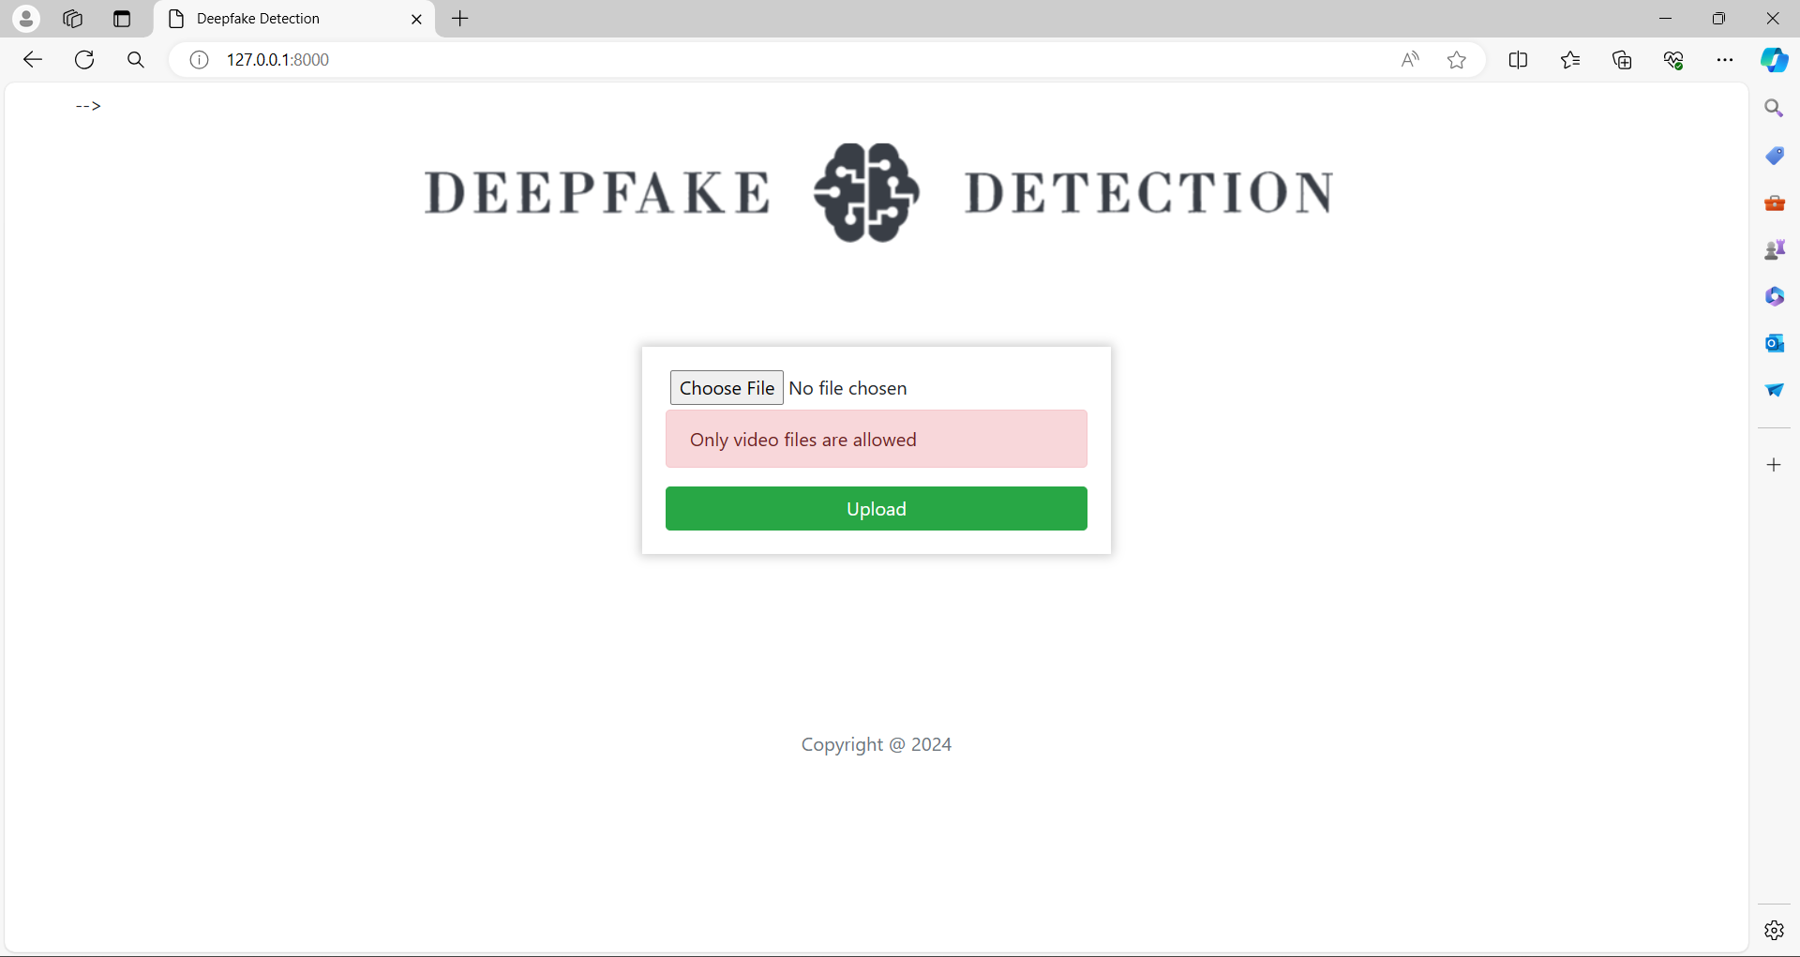
Upload a non video file

Slide 27

Output after uploading a no face video video

Slide 28
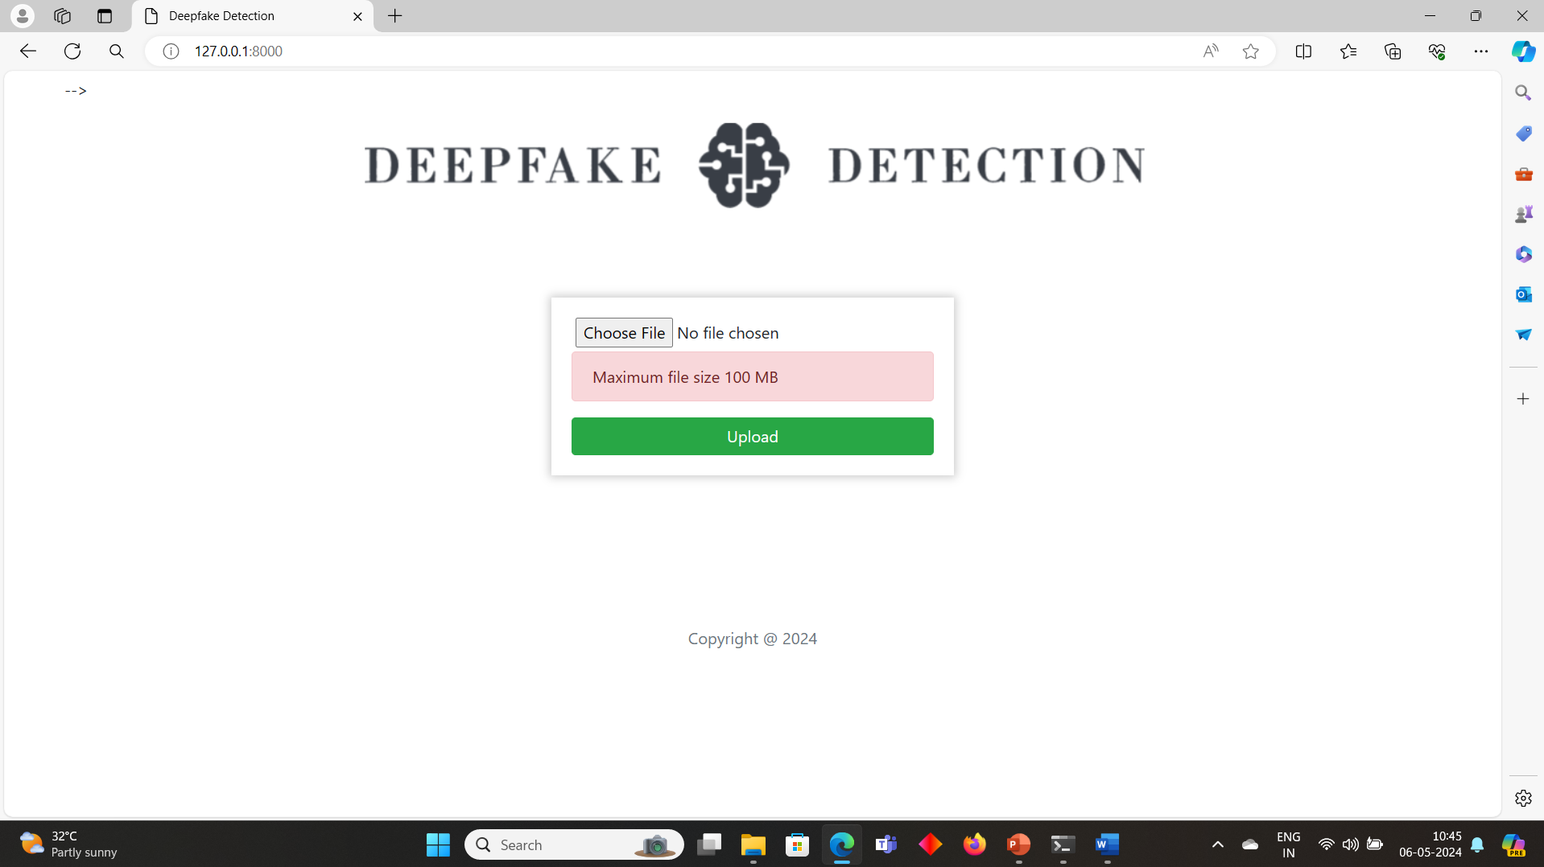
Upload video larger than 100MB

Slide 29
Result Analysis
Case id | Test case description | Expected Result | Actual Result | Status
1 | Upload a word file instead of video | Error message: Only video files allowed | Error message: Only video files allowed | Pass
2 | Upload a 200MB video file | Error message: Max limit 100MB | Error message: Max limit 100MB | Pass
3 | Upload a file without a face | Error message: No faces detected. Cannot process the video | Error message: No faces detected. Cannot process the video | Pass
4 | Videos with many faces | Fake/ Real | Fake | Pass
5 | Deepfake video | Fake | Fake | Pass
6 | Real video | Real | Real | Pass
7 | Press upload button without selecting video | Alert message: Please select video | Alert message: Please select video | Pass

Slide 30
CONCLUSION
Our team introduced a neural network technique for distinguishing between deepfake and authentic videos, complete with a measure of our model's confidence.
Our approach can analyse 2 second of video (capturing 10 frames per second) and deliver accurate predictions.
We employed a pre-trained ResNext CNN model to capture frame-level features and an LSTM for processing temporal sequences, enabling us to identify alterations between consecutive frames (t and t-1).

Slide 31
Future Scope
Web based platform can be upscaled to a browser plugin for ease of access to the user.
Currently only Face Deep Fakes are being detected by the algorithm, but the algorithm can be enhanced in detecting full body deep fakes.

Slide 32
References
TensorFlow: https://www.tensorflow.org/ (Accessed on 26 March, 2020)
Keras: https://keras.io/ (Accessed on 26 March, 2020)
PyTorch : https://pytorch.org/ (Accessed on 26 March, 2020)
G. Antipov, M. Baccouche, and J.-L. Dugelay. Face aging with conditional generative adversarial networks. arXiv:1702.01983, Feb. 2017
J. Thies et al. Face2Face: Real-time face capture and reenactment of rgb videos. Proceedings of the IEEE Conference on Computer Vision and Pattern Recognition, pages 2387–2395, June 2016. Las Vegas, NV.
Deepfake Video Detection using Neural Networks http://www.ijsrd.com/articles/IJSRDV8I10860.pdf

Slide 33
Thankyou

